Slide 1
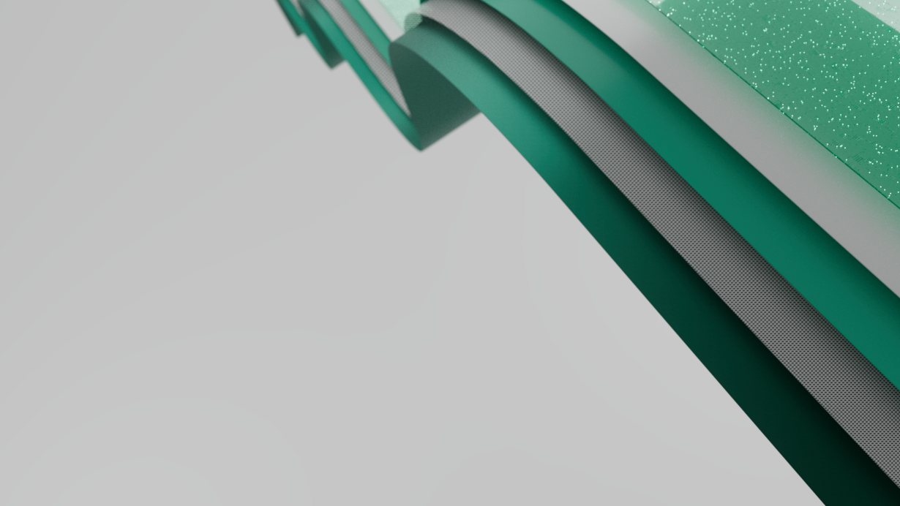

Synapse Real-Time Analytics in Microsoft Fabric

Slide 2

Paradigm shift in Data Consumption
Notes:
In the past, accessing data was a challenge.
To read a book, you had to go to a library or buy a copy.
To see a movie, you had to go to the cinema or wait for it to air on TV.
And to listen to music, you had to buy a CD or cassette tape, or wait for your favorite song to play on the radio.

Slide 3

Paradigm shift in Data Consumption
Notes:
But today, things have changed.
The internet has revolutionized the way we consume data, making it more accessible to everyone.
A huge variety of applications have made it easier than ever to consume data on the go. For example, if you want to read a book, you can download it onto your e-reader or tablet using your favorite e-book store. This means you no longer have to visit a physical library or bookstore to get a copy.

Slide 4

Paradigm shift in Data Consumption
Notes:
Now, you can access a vast array of digital content from anywhere in the world, directly from your mobile phone.

Slide 5

Paradigm shift in Data Consumption
Notes:
The same goes for movies and TV shows. You no longer have to wait for your favorite program to air on TV or go to the cinema to see a new release. Streaming services provide unlimited access to an enormous library of content, available anytime and anywhere, right from your smartphone.
This shift has truly democratized the way we consume data. Today, most of these activities are done from applications, accessed from your phone.

Slide 6
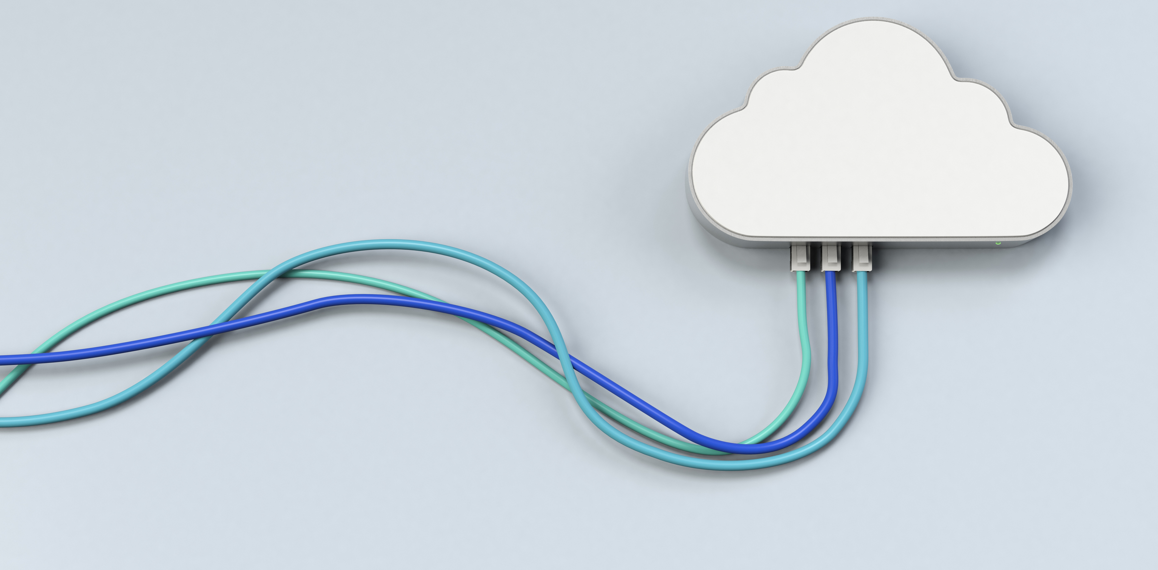
Paradigm shift in Data Consumption
Notes:
Cloud platforms provide the backbone for these experiences, hosting and analyzing the vast amounts of data that drive them.
These platforms are accessible from anywhere in the world, on any device, making it easy to access this data on the go.
Data then, has become interactive, on demand, and available to everyone.

Slide 7

Paradigm shift in Data Consumption
Big Data Platforms
Terabytes of data
Low latency
High freshness
Streaming technologies
Index everything by default
Notes:
This has been made possible by the evolution of cloud technologies and cloud platforms.
Over the past few years, they have become capable of supporting terabytes of data with low latency and high freshness.
Streaming data, from injection to query, is easily accessible by customers. Additionally, data is pre-indexed and pre-partitioned by default.
As a result of these improvements, working with data has become an essential part of the day-to-day workflow for companies all over the world.

Slide 8
Enterprises are still behind in handling real-time data consumption
Notes:
Even as our personal lives have moved towards near-instant data access, enterprises have struggled to keep up.
So, despite the data revolution, many companies are still behind when it comes to fully utilizing their own data to make smart decisions, to improve operations, and customer success.

Slide 9

Time for a Digital Transformation
As enterprises rely more on digital technologies for operations and customer interactions, monitoring and analyzing IT systems in real-time have become essential.
Notes:
As enterprises rely more on digital technologies for operations and customer interactions, monitoring and analyzing IT systems in real-time have become essential.
The good news is that at Microsoft we have created a new tool to bring real-time analytics within reach of businesses of all sizes.

Slide 10
With Real-Time Analytics in Fabric, we help organizations scale up their analytics solution and democratize data for advanced and citizen data scientists.
Notes:
With Real-time analytics in Fabric we want to bring the paradigm shift that happened in our real lives to the business world.
In the same way today you can just go and buy books, music or movies online, we want you to have the same “easy to use” and friendly experience when it comes to working with real-time data.
By democratizing data for both citizen and advanced data scientists, we created a powerful analytics solutions that can be used by anyone in you organization, regardless of their expertise or job duties.
The result is a more agile, data-driven organization that is better equipped to take on the challenges of today's dynamic business environment.

Slide 11
Real-Time Analytics is built on top of Azure Data Explorer Engine
Notes:
The Real-time Analytics experience in Fabric, is built on top of Azure Data Explorer Engine, AKA Kusto, with a focus on accessibility, having full integration with other Fabric experiences

Slide 12

Real-Time Analytics in Fabric - Reducing Complexity
One Logical Copy
By-default streaming ingestion
By-default indexing everything
Time and Hash based data partitioning
Native support for structured, semi-structured and free text data
In-place transformation
Notes:
Here’s how we reduce complexity with Real-time Analytics in Fabric.
Fabric offers support for a single logical copy of your data, to help maintain consistency and eliminate data silos.
Streaming ingestion is enabled by default, so you can import data continuously.
Data is partitioned by both time and hash by default, so you don’t need to worry about scalability and query performance during data ingestion.
Also, data is indexed by default, making it easy to search and analyze later.
There’s native support for structured, semi-structured, and free text data, so you can analyze any type of data in your organization.
For example, our solutions will automatically infer the shape of the data and create tables based on that shape.
Also, you can transform data in-place as needed without moving it to a separate system.

Slide 13
Real-Time Analytics in Fabric - Simplifying
Tightly integrated with Fabric experiences
Mirroring to Lakehouse
By-default integration with event streaming sources
By-default integration with Power BI
Notes:
By being integrated with other Fabric experiences, Real-time analytics also simplifies how you work with your data.
You can easily create Power BI reports on every dataset or explore them via notebooks.
By-default integration with event streaming sources lets you ingest data in real-time from sources like Azure Event Hubs.
All this can be achieved via a no-code, drag and drop user experience.
This helps to ensure that everyone has access to the same data and insights, which is essential for making informed business decisions.

Slide 14

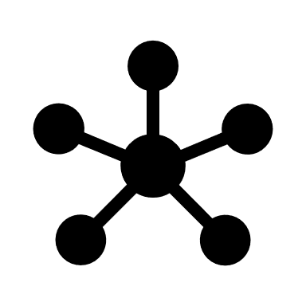
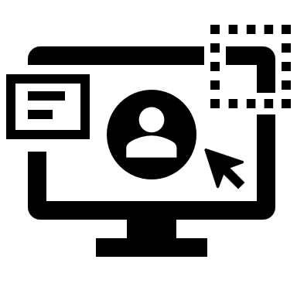
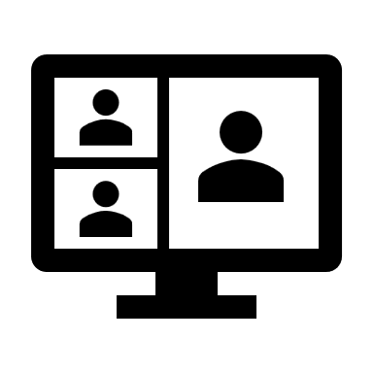
Real-time Analytics in Fabric
Auto-managed scale
Cross workload solutions
Easy onboarding with friendly UX
Managed experiences
Notes:
Thanks to being powered by Azure Data Explorer, you can store, query, and gain insights into vast amounts of data.
The system is highly scalable and optimized for performance, able to adjust capacity to your usage patterns and needs, allowing for seamless performance no matter the number of users.
With an intuitive query language like KQL, everything is easy to get started with.
Also, the system is fully managed, so you can focus on your data and your business, without having to worry about scaling or partitioning.

Slide 15
Solving the
Single Source of Truth
problem
Notes:
Also, by being fully integrated with other Fabric experiences, with Real-time Analytics, we've solved the single source of truth problem.
We've consolidated all your data into one central workspace, so you can be confident that you're working with the most accurate, up-to-date information.

Slide 16
Real-time Analytics - Key capabilities
Unlimited scale (query, ingestion, storage)
Any data source
Any data format
Structured, semi-structured, free-text data
Notes:
Many artifacts Messaging with Even Hubst, KQL database, KQL queryset.
Any data soource: different clouds, on prem. CSV, parquet.
You can query text, json, arrays, structured data.

Slide 17
Real-time Analytics - Key capabilities
Real-time data transformation of complex data structures
Streaming analytics in Near Real Time
High performance, Low latency, freshness
Notes:
Built-in streaming. 200gb per core per minute
Access the data in seconds, once ingested
Suppots time series.

Slide 18


Highlighted industry scenarios
IOT Analytics
Log analytics (security)
Notes:
Some of the highlighted industry scenarios for Real-time Analytics are IOT Analytics and Log analytics

Slide 19

Highlighted industry scenarios
Cybersecurity
Asset tracking and management
Predictive maintenance
Supply chain optimization
Customer experience
Energy management
Notes:
Which you can extend across different industries, like:
Cybersecurity
Asset tracking and management
Predictive maintenance
Supply chain optimization
Customer experience
Energy management

Slide 20
Highlighted industry scenarios
Inventory management
Quality control
Environmental monitoring
Fleet management
Health and safety
Notes:
Also you can use real-time analytics for scenarios like
Inventory management
Quality control
Environmental monitoring
Fleet management
Health and safety
Basically, if you have time based events that require data streaming, like telemetry data, then with Real-time analytic you are at the right place.

Slide 21
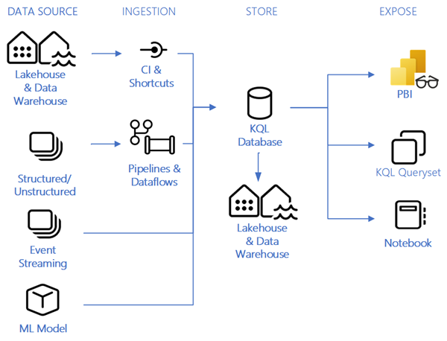
Real-time Analytics
Notes:
As you could see in the demo,
You can stream data from Event Hubs directly into Real-Time Analytics.
The underlying Kusto engine is able to detect the data format, and infer the database table structure from it.
Then you can query the data directly by using KQL.
Thanks to the Power BI integration, you can visualize the data to gain powerful insights from it, all into a managed experience in Fabric.

